Slide 1

FRAGGY (ENEMY)
By João Neto (a22200558)

Slide 2
Why is it a good enemy?
Fraggy’s bullets split in three at the first ricochet, having each of them a slight variation in angle.
Its special bullets were designed especially for open areas, where Fraggy’s bullets make possible to cover a bigger area of the map.
Its mechanic also forces the player to move more, the extra bullets are great for making the expose himself more in order to avoid them.

Slide 3
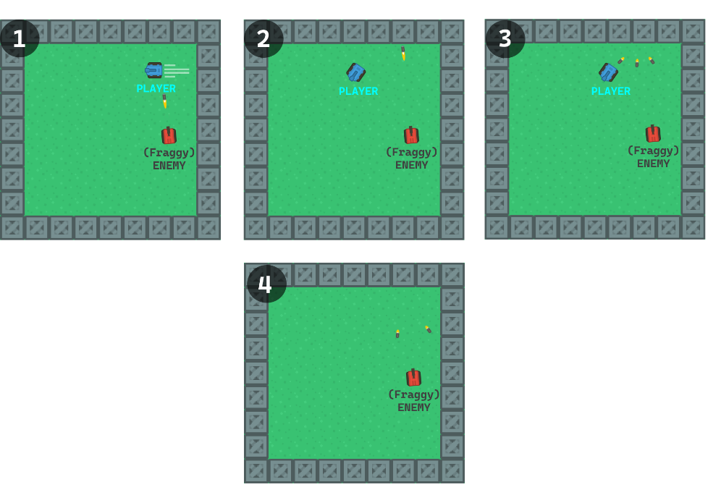
Mockup

Slide 4
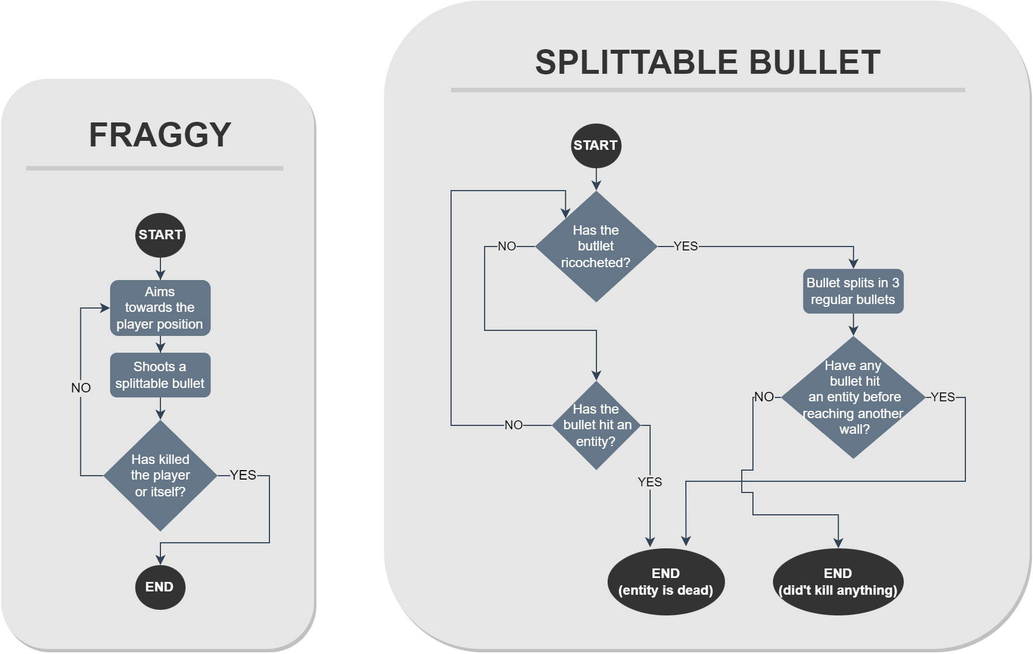
Flowchart

